Slide 1


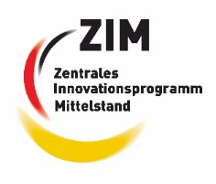

Investigation of the Coloring Behavior of Zirconiumdioxide (ZrO₂) Dental Ceramics by Ink-jet Printing of Metal-ionic Inks
Furkan Öztürk
Betreuer: Dipl.-Ing. Dominik Rumschöttel
Notes:
Thank you for taking the time to listen to the interim presentation of my master’s thesis: “Investigation of the Coloring Behavior of Zirconiumdioxide (ZrO₂) Dental Ceramics by Ink-jet Printing of Metal-ionic Inks"

Slide 2
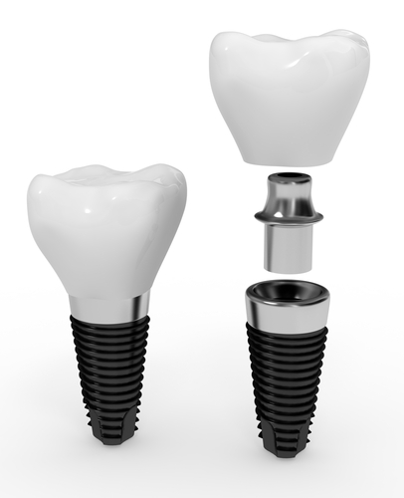
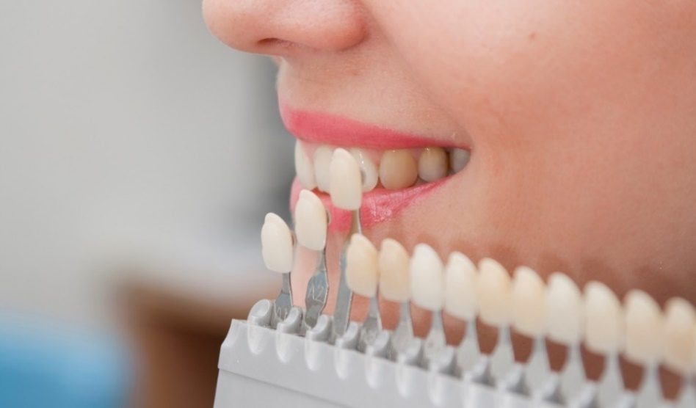
1. Application
More then 1 Million tooth replacements annually
(Deutsche Gesellschaft für Implantologie im Zahn-, Mund- und Kieferbereich e. V.
(DGI), 2018)
Zirconia the most popular material
Translucent ceramic crowns (Vasiliev, 2011)
Crown, abutment and implant
(ecoDenta)
Color determination procedure
Notes:
Only in Germany more than 1 M teeth are replaced annually.
And the most popular crown material is Zirconia
-but zirconia in its pure form is plain white so coloring the crown is necessary
-dentist are using such a shade guide for a side by side comparison to determine the color and the shade of the teeth.
- you will see that there are 4 color groups A B C and D and each of these colors have 4 shades coded with the numbers from 1 to 4. Where 1 is the least and 4 is the most saturated shade for each color.

Slide 3
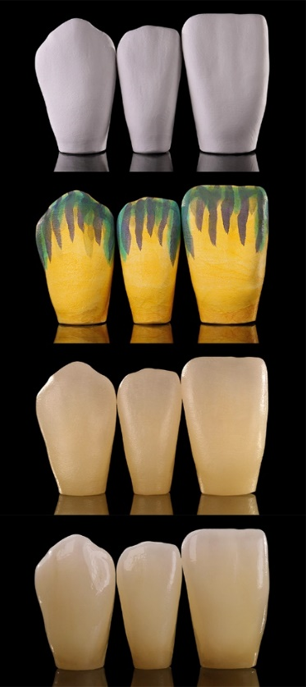
2. State of the Art
Making of dental implants by
dental technologist:
Milling
Manual
Coloring
Furnacing
Polishing
Markings made by dentist
Cutout of a lab card (Sharpling, 2015)
(Zirkonzahn GmbH, 2018)
Notes:
On the left side you can see a cutout of a lab card. Dentists mark different areas of the crown with different colors from the guide for the technicians.
And on the right side are the tasks of a dental technician, which are mainly:
-Milling
-Manually coloring using a brush
-furnacing to burn the color to the Zirconia
-and lastly polishing for a natural look.
And the coloring part is the process, on which this thesis is focused

Slide 4
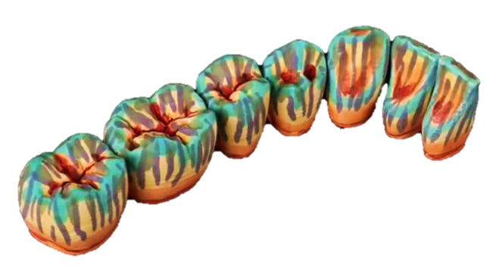
3. Drawbacks of the State of the Art
Time consuming : ~ 5 Minutes per tooth (IDS CAD Ltd., 2015)
Experienced dental technologists needed
Color differences between adjacent teeth
Lack of quantitative knowledge of process
parameters impedes automation
16+ different inks needed for
the full color scale
False colored crowns after manual brushing (Zirkonzahn GmbH, 2018)
Notes:
Currently there are some drawbacks to the state of the art. 1 Coloring a single tooth takes about 5 min, so for multiple teeth a considerable amount of time is required
2 If the experience of the dental technologist is not satisfactory, color differences may appear between sequential teeth
3 The whole crown coloring process relies on some qualitative recipes and mostly on experience, so there is no data like how much ink is required per mm^3 to obtain a color of A3 or B4 on the zirconia.
4 Also the number of inks needed to acquire those shades is unnecessarily high.
This is what the crowns look like after the technician is done with the manual coloring process.

Slide 5
4. Assignment
Development of a process for the generation of dental color shades using an inkjet printer
Establishing the specifications of the printing system (Drop volume, repetition rate, max. printing distance…)
Selection of a proper droplet generator (Piezoelectric vs. Electromagnetic)
Verification of the process results with the existing color standards
Notes:
In frame of this thesis
-a process is to be developed for generation of the dental color shades using an inkjet printer.
-the specs of the printing system, like drop volume or the max printing distance, are to be determined.
-Afterwards an adequate droplet generator is to be selected.
-With piezoelectric droplet generators, smaller and faster drops are possible but electromagnetic ones are cheaper.
-At last the generated shades are to be verified with the existing color standards

Slide 6
5. Advantages
Detailed knowledge of the printing process is the prerequisite for successful automation
Determination of the needed droplet generator type early in the product development cycle
Creation of 16+ color shades with only 5 inks by halftone printing
Notes:
One of the most important advantages is quantification of the coloring process followed by the printing process.
So that, the automated printing can be enabled.
Determining the adequate drop volume provides us the needed information for selecting the droplet generator type early in the product development cycle.
Also, the whole spectrum of shades can be obtained with only 5 inks by halftone printing.

Slide 7
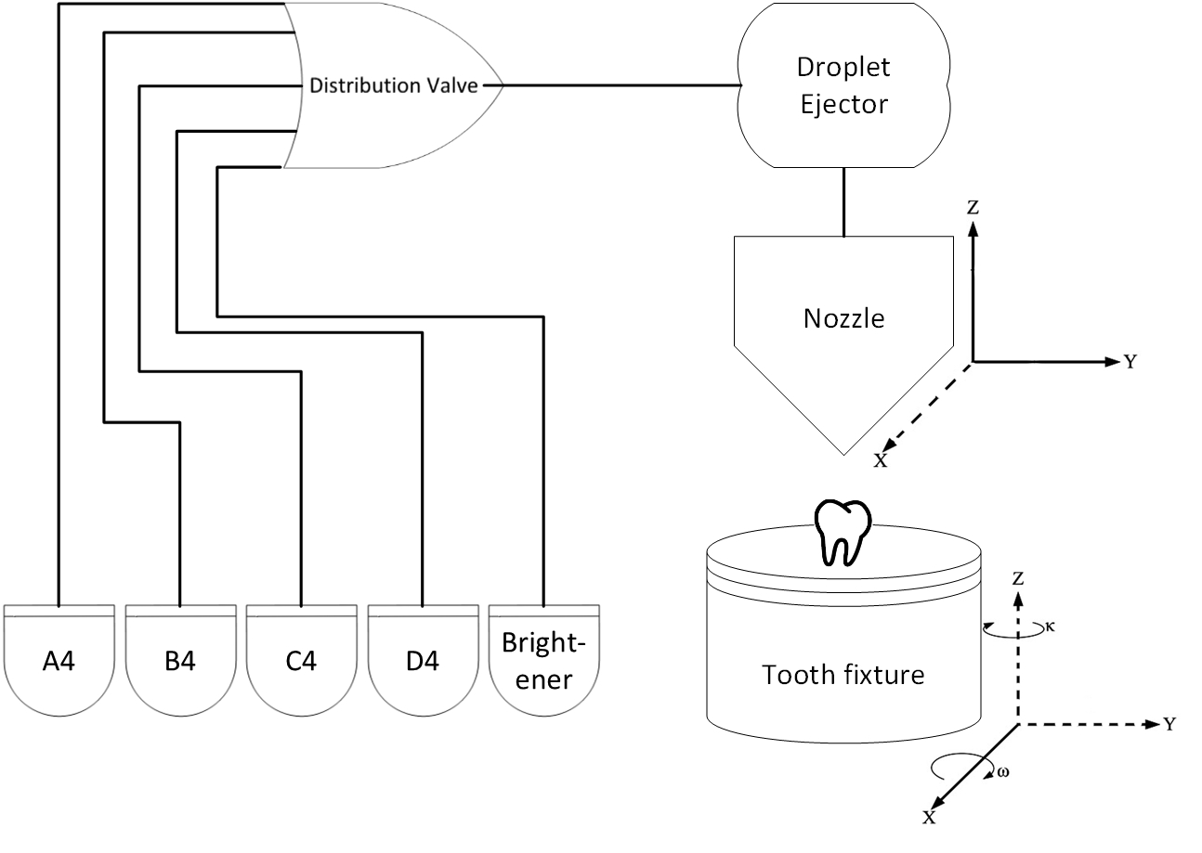
6. Concept (Structure)
5-Axis printing System
Single Nozzle droplet generator
Mixing the 4 base inks with a brightener to obtain 16+ shades
Conceptual design of the printing System
Notes:
The structural concept is utilization of a 5-axis printing system.
-4 base colors with the highest saturation (A,B,C and D4) are to be used with the brightener instead of 16 predefined shades.
-The amount of the brightener defines the shade of the color.
-A 3-axis table and the 2-axis nozzle holder are responsible for the coordination during the printing process..

Slide 8
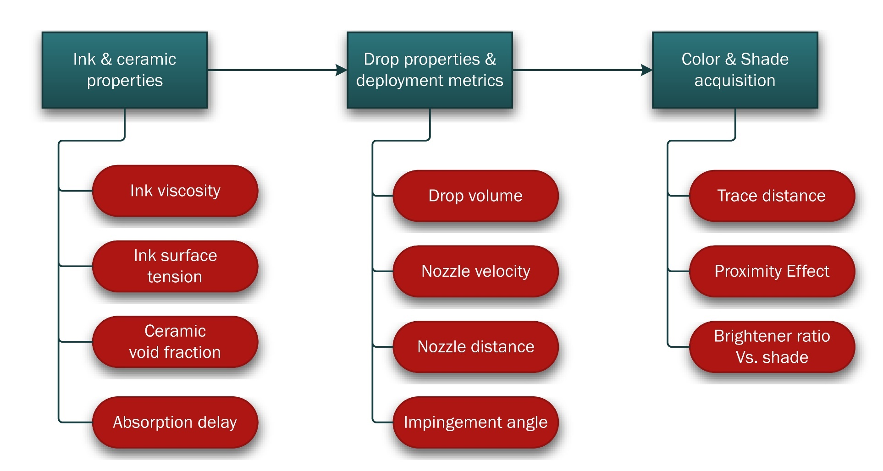
7. Concept (Process)
Drop impingement analysis
Diffusiveness parameters
Resolution optimization
Multicolor shade arrangement
Notes:
The process concept is realized in three stages. Each stage depends on the previous one and That’s the progress so far.

Slide 9
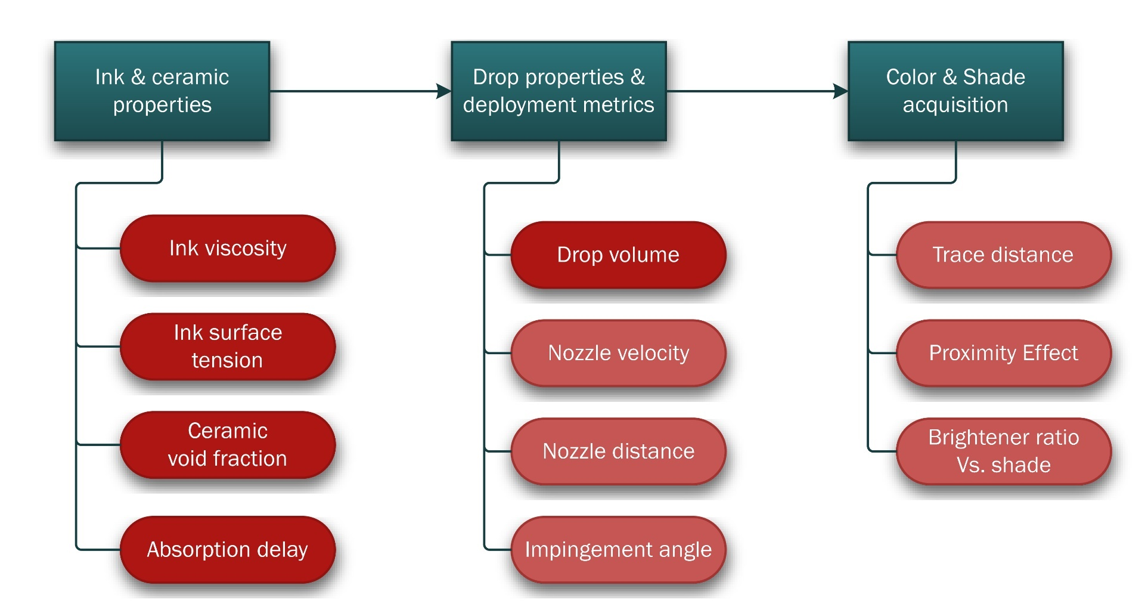
7. Concept (Process)
Drop impingement analysis
Diffusiveness parameters
Resolution optimization
Multicolor shade arrangement
Notes:
-First stage is finding the ink and ceramic properties, such as ink viscosity and surface tension, ceramic void fraction and ink absorption time.
-Second stage is determination of drop properties and deployment metrics, which consist of drop volume, nozzle escape velocity of the drops, the optimal distance between the nozzle and zirconia surface and the angle between the drop projectile and the surface.
-The aspects to be considered under the third stage color and shade acquisition are trace distance (the distance between two sequential lines on the printed surface), proximity effect, which refers to how the proximity of two colored areas affect the shade of the uncolored area in between and finally the dependency of the shade on the brightener ratio

Slide 10
8. Claim
First automated printing approach in
dental coloring
First color shade generation approach using
base ink colors with a brightener
Notes:
The project is the first automated printing approach in dental coloring and also the first time the shades are generated using the darkest base colors and a brightener

Slide 11
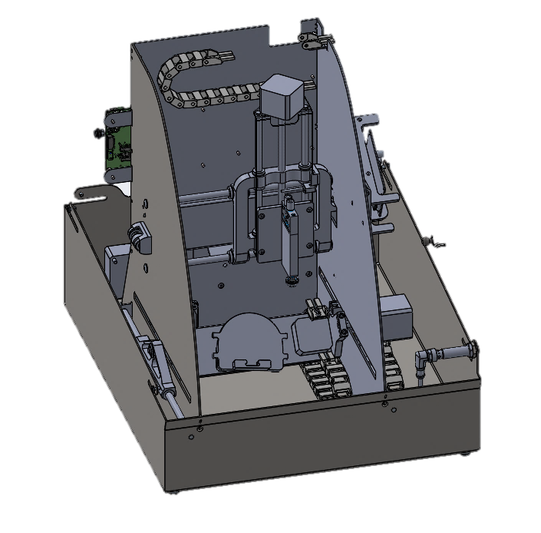
9. Experimental Equipment
Droplet ejector
Stepper motor actuated 5-Axis printing system
Piezoelectric valve based single nozzle printhead with external pressure supply
5 inks alternatively activated by a distribution valve
G-Code based Control Software
X&Z-Axis
Single Nozzle
Y-Axis
Rotation &
Tilt axes
5-axis printer design for dental ink (Matthias Leininger, Bredent GmbH)
Notes:
Before moving on to the experiments I want to show you the 5 axis printing system prototype provided by Bredent for conduction of the experiments.
It utilizes a
-single nozzle printhead with
-a piezoelectric valve to generate the droplets.
Ink selection, positioning and drop generation commands are given with a G-Code.

Slide 12
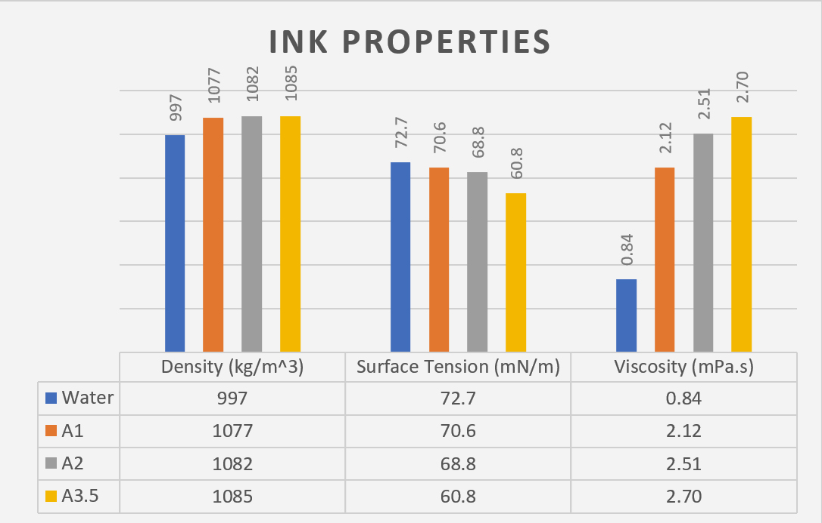
10. Experiment 1 (Material Properties)
Quantitative information for automation
Density, surface tension, and viscosity measurements with
Haake RS100 Viskometer
Lauda TD1 Tensiometer
Dental inks provided by ON-DENT Ltd.
Porosity measurement of the Zirconia blank via gravimetric method
43% Void fraction
Notes:
For a dental technician it is totally trivial how viscous the ink is but for an automated printing process the quantization of the properties is highly important. -In the first experiment, the properties of the coloring agents A1, A2 and A3.5 are determined and compared to those of water. -The inks have a similar density to water, but with increasing coloring agent the surface tension gets lower and the viscosity gets 3 times higher when compared to water.
Also, a porosity measurement for the zirconia is conducted, which revealed a 43 percent void fraction.

Slide 13
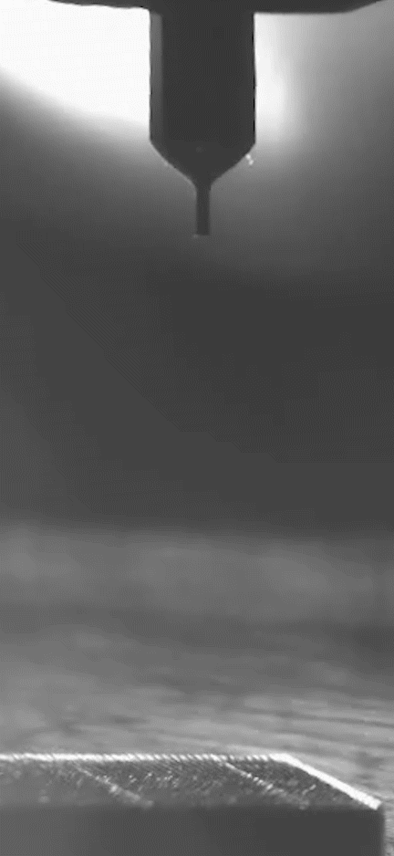
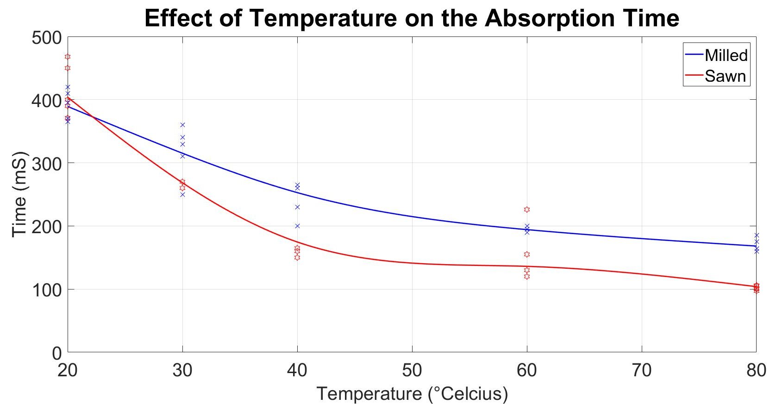
10. Experiment 2 (Absorption Time)
Absorption time limits maximum printing speed
Finding out whether a heater is necessary
Absorption of 100 nL Drops on the Zirconia Surface
( 35x slower)
A change of 60 ºC causes 50% reduction in time
Notes:
The second experiment is about the absorption time of the droplets, which limits the printing time.
We wanted to see whether a heat source can accelerate the absorption or not.
The Absorption times are measured at temperatures ranging from 20 to 80 deg cels.
The results show that a change of 60 degrees provide a 50% reduction in time.

Slide 14
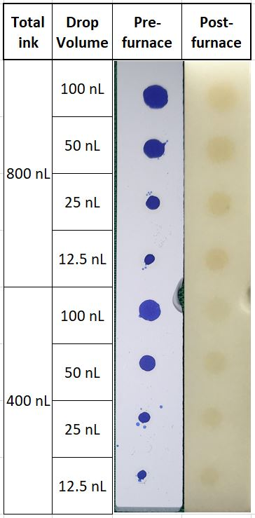
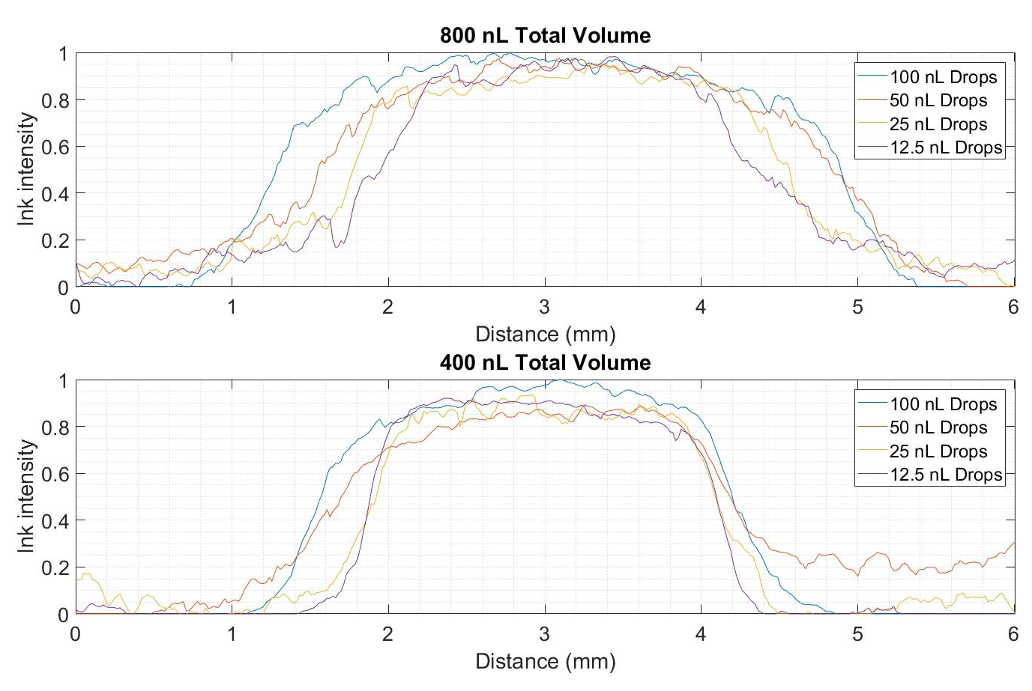
10. Experiment 3 (Drop Size)
Choice of droplet generator (piezoelectric or magnetic) depends on the needed droplet size
Lateral color distribution in relation to the drop volume
Notes:
The purpose of the third experiment is deciding for an adequate drop size.
Depending on the drop size the drop generator is to be selected.
In this figure you can see a printed zirconia specimen.
Each spot on the upper half has a total ink volume of 800 nL and the ones on the bottom half 400 nL.
These spots are printed using drops with volumes of 100, 50, 25 and 12.5 nL.
The first image shows the spots right after printing. The second one shows the surface after furnacing. A larger drop size results in shorter print duration. However they also tend to expand the spot area more compared to the smaller drops as you can see, which is bad for the resolution.
The graphs show the ink intensity along the red lines and the spreading of the ink in lateral direction for each drop volume.
12.5 and 25 nL drops result in a similar spot diameter but the spots tend to get significantly larger with 50 and 100 nL Drops.

Slide 15
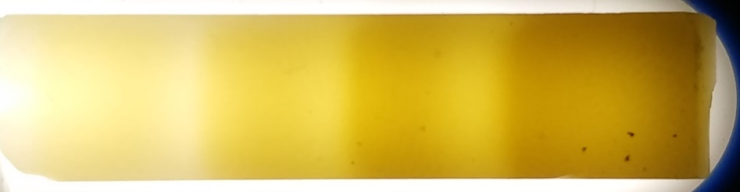
11. Summary
Automated inkjet printing of dental colors is proven to be possible
25 nL is the largest drop size that does not negatively impact the printing resolution
Contrary to the statements of the ink manufacturer the ink properties differ significantly from the properties of pure Water
Zirconia specimen with 4 shades of the color A
Notes:
In summary the general inkjet printing concept is proven to be possible.
Here you can see 4 shades generated on the zirconia specimen.
25nL is the largest volume which doesn’t have a negative impact on the resolution.
It is also revealed that the ink properties differ significantly from the properties of pure water in contrast to the manufacturers claim.

Slide 16
12. Outlook
Optimization of ink application on the surface
Nozzle velocity
Max. distance
Max. impingement angle
Developing a model for the shade composition
Trace distance
Proximity effect
Brightener to base ink ratio
Notes:
There is still a lot to be done in frame of the thesis.
The optimum nozzle velocity,
maximum allowed distance and
impingement angle are to be determined in order
to optimize the coloring method.
But most importantly a model for the shade composition over the entire zirconia surface has to be created ,
regarding the trace distance,
proximity effect and
brightener ratio.

Slide 17
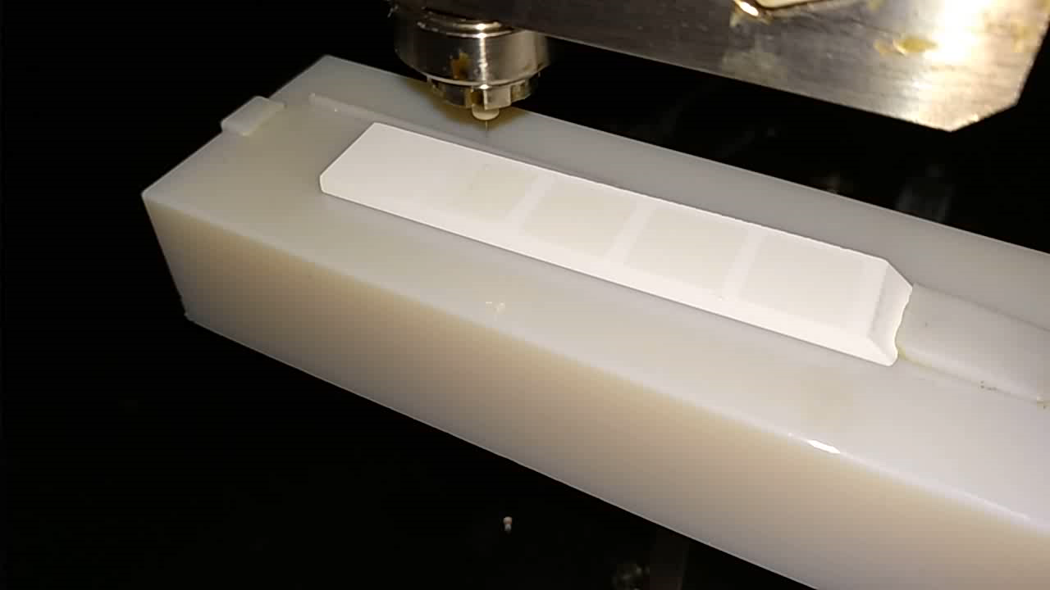
13. Printing process
Printing process on a zirconia specimen
Notes:
As an extra I want to show you the printing process.

Slide 18

Thank You!
References:
IDS CAD Ltd., (2015). Chang’s coloring liquid. Retrieved from https://www.idscad.com/wp-content/uploads/2016/11/liquid-brochure-1-1.pdf
Lee, J. B., Radu, A. I., Vontobel, P., Derome, D., & Carmeliet, J. (2016). Absorption of impinging water droplet in porous stones. Journal of colloid and interface science, 471, 59-70.
Sharpling, B., & Wilson, N. (2015). Teamwork with the Dental Technologist. In Principles and Practice of Esthetic Dentistry (pp. 215-229).
Vasiliev, A. A., Lipilin, A. S., Lagutin, A. S., Pisliakov, A. V., Zaretskiy, N. P., Samotaev, N. N., & Sokolov, A. V. (2011, May). Gas sensors based on MEMS structures made of ceramic ZrO 2/Y 2 O 3 material. In Smart Sensors, Actuators, and MEMS V (Vol. 8066, p. 80660N). International Society for Optics and Photonics.
www.mimed.de
Notes:
Thank you for your attention.

